Slide 1
Negotiation Fundamentals
Reading 1.2
Selecting a Strategy;
Competitive/Distributive

Slide 2

Negotiation

Slide 3
Another Definition of Negotiation
A strategic endeavor directed toward the specific ends of reaching agreements and satisfying negotiators’ needs.
  Strategies are the pre-formulated game plans, objectives, and approaches that guide negotiators in reaching their goals
  Tactics are the specific ways bargainers implement these strategies.
                From “Strategy of Conflict” by Schelling

Slide 4

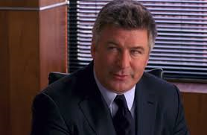
30 Rock Video:
Negotiating with Jack Donaghy
https://www.youtube.com/watch?v=a7-eoiY4bOo

Slide 5

Five Negotiation Strategies
Competing
Collaborating
Compromising
Avoiding
Accommodating

Slide 6
Competing
The goal is “to win”
Winning the deal without regards for a relationship

Slide 7
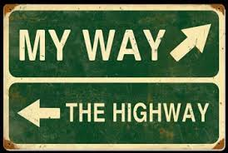
Competing
Quick action
Unpopular decisions
Vital issues
Protection
High Assertiveness and Low Cooperativeness

Slide 8

Overuse of Competing
Lack of feedback
Reduced learning
Low empowerment
Surrounded by “yes men and women”

Slide 9
Collaborating
The goal is “to find “ find a win- win solution”
Interested in the relationship outcome

Slide 10

Collaborating
Integrating solutions
Learning
Merging perspectives
Gaining commitment
Improving relationships
High Assertiveness and High Cooperativeness

Slide 11
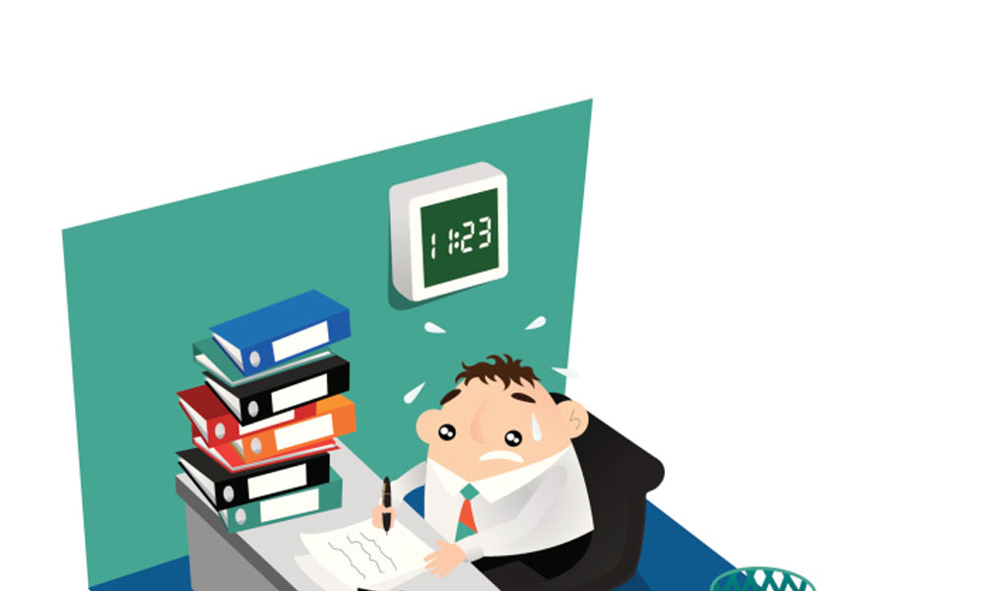
Overuse of Collaborating
Too much time on trivial matters
Diffused responsibility
Others may take advantage
Work overload

Slide 12
Compromising
The goal is “to find a middle ground”
Split the difference

Slide 13
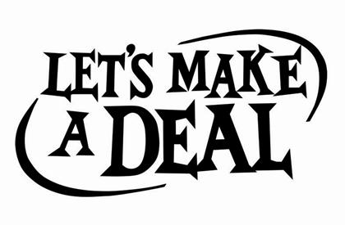
Compromising
Moderate importance
Equal Power – Strong Commitment
Temporary solutions
Time constraints
Backup
Moderate Assertiveness and Moderate Cooperativeness

Slide 14

Overuse of Compromising
Loss big picture/long term goals
Lack of values and trust
Cynical climate

Slide 15
Avoiding
The goal is “to delay”
Not interested in neither substance or relationship

Slide 16
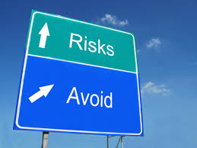
Avoiding
“I’ll think about it tomorrow”!
Issues of low importance
Reducing tensions
Buying time
Low power
Allowing others
Symptomatic problems
Low Assertiveness and Low Cooperativeness

Slide 17

Overuse of Avoiding
Lack of input from you
Decision made by default
Issues fester
Cautious climate

Slide 18
Accommodating
The goal is “to yield”
Interested in both the deal substance and relationship

Slide 19

Accommodating
“It would be my pleasure”!
Showing reasonableness
Developing performance
Creating good will
Keeping “the peace”
Retreating
Low importance
High on Cooperativeness and Low on Assertiveness

Slide 20
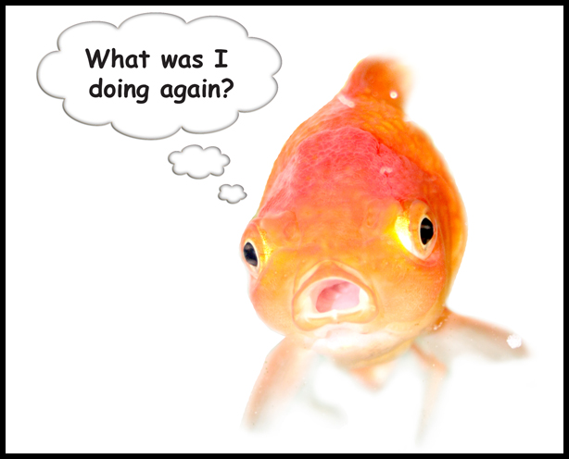
Overuse of Accommodating
Ideas get little attention
Restricted influence
Loss of contribution
Anarchy

Slide 21

The Starting Line
Before you determine/plan your strategy, you should first decided if or how much you are concerned with:
The relationship with the other negotiator
The outcome of the negotiation

Slide 22
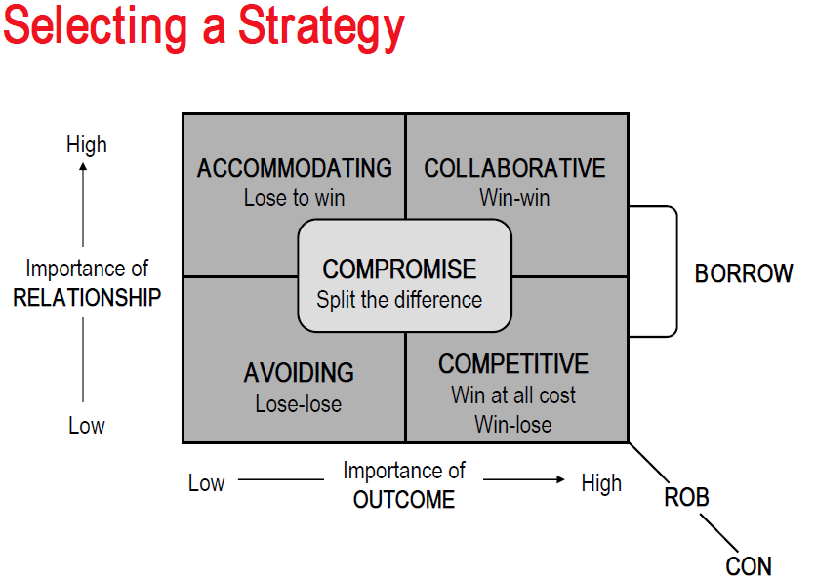

Slide 23
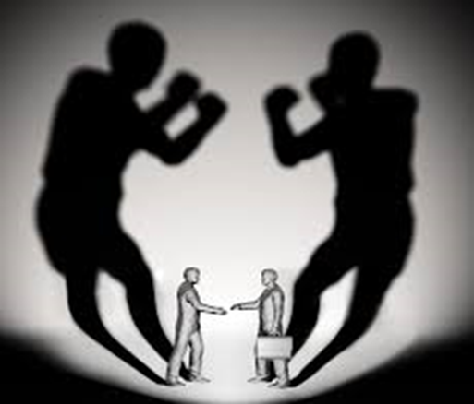
Competitive/ Distributive Strategy (Win-Lose)
Selecting a Strategy

Slide 24

Competitive (Distributive) Strategy
The Competitive Strategy is used frequently, so it is important to understand how it works.

Slide 25
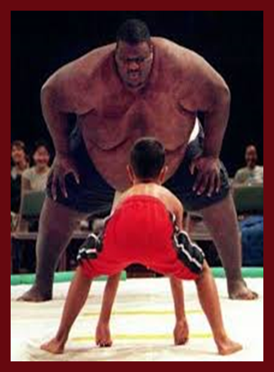
Competitive (Distributive) Strategy
Common elements (WIN-LOSE)
  The outcome of the negotiation is more important than the relationship.
  Competitive party wants to get as much as the finite outcomes as possible.
  The goal is to get the other party to give in, and thus, satisfy the competitor’s needs – now!

Slide 26

Competitive (Distributive) Strategy
Critical Factors
A Well-Defined Bargaining Range
A Good Alternative
Tactics
Results and Drawbacks of Using a Competitive Strategy

Slide 27
Well-Defined Bargaining Range
Preparation—set a:
  Starting point (i.e., “asking price”)
  Target point or aspiration point – the point which a negotiator would like to conclude at
  Ending or walkaway point – the negotiator’s bottom line
  Initial offer – the first number to counter the starting point

Slide 28
Well-Defined Bargaining
Range (cont)
Party A - Seller
Walkaway Point Target Point Starting Point
(Asking Price)
Initial Offer Target Point Walkaway Point
Party B - Buyer
2-28

Slide 29
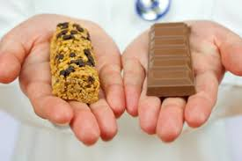
Alternatives
Definition
  The walk-away possibilities that each party has if no agreement is reached
  If you don’t reach an agreement, what alternatives do you have?

Slide 30

Alternatives (cont)
Alternatives give the negotiator power to walk away from the negotiation
  If alternatives are attractive, negotiators can:
    Set their goals higher
    Make fewer concessions
  If there are no attractive alternatives:
    Negotiators have much less bargaining power

Slide 31

Good Alternatives
Party A - Seller
Walkaway Point Target Point Starting Point
(Asking Price)
Initial Offer Target Point Walkaway Point
Party B - Buyer
2-31

Slide 32
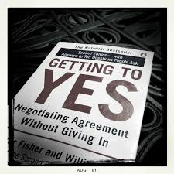
BATNA
BATNA is a term coined
by Roger Fisher and
William Ury in their
1981 bestseller,“Getting
To Yes: Negotiating
Without Giving In.”
BATNA is the acronym
for Best Alternative To
a Negotiated Agreement

Slide 33



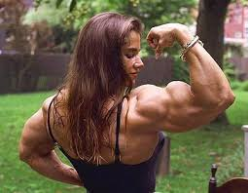
For Example ….
You want to buy a new car…
The same model is for sale at several car
dealers…
So, you have a strong BATNA!!!

Slide 34
Effective negotiators determine their BATNAs before talks begin
It is critical to establish a walkaway point that is firmly grounded in reality

Slide 35
Determining Your BATNA
List your alternatives if current negotiation ends in an impasse. What are your no-deal options
Evaluate your alternatives
Establish your BATNA – the course of action if the current negotiation fails
Calculate your walk-way value – the lowest value deal you are willing to accept

Slide 36
If the proposed agreement is better than your BATNA, then you should accept it !
If the agreement is not better than your BATNA, then you should reopen negotiations or walk away!

Slide 37
BATNA he
Party A - Seller
Walkaway Point Target Point Starting Point
(Asking Price)
BATNA
BATNA
Initial Offer Target Point Walkaway Point
Party B - Buyer
2-37

Slide 38

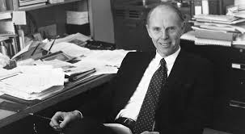

The reason you negotiate is to produce
something better than the results you can
obtain without negotiating !!!
Roger Fisher and William Ury

Slide 39
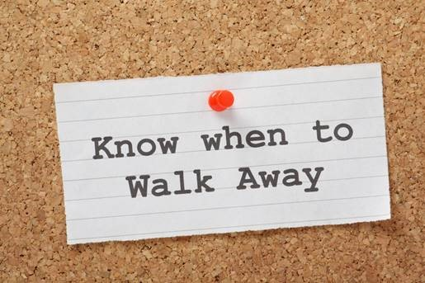

Slide 40
Process and Strategy in Competitive Negotiations
The process of competitive negotiation involves the interplay of one's walk away value
The trick is to get an idea of your opponent's walk away value and then try to negotiate an outcome that is closer to your own goals than theirs

Slide 41
Process and Strategy in Competitive Negotiations (cont)
INFORMATION is the key to gaining a strategic advantage in a competitive negotiation.
To a large extent, your bargaining power depends on how clear you are about your goals, alternatives, and walk away values and how much you know about your opponents.

Slide 42

Results and Drawbacks of Using a Competitive Strategy
Lost time and goodwill
Used by inexperienced negotiators
Make wrong assumptions about the other party
  Self-filling prophecy

Slide 43

Techniques You Might Use to Shift the Win-Lose To a Win-Win
Reduce tension through humor
Listen actively
Make a small concession as a signal of good faith
Increase the accuracy of communication
Listen hard in the middle of conflict
Mirror the other's views
Control issues
Slice the large issue into smaller pieces
Depersonalize the conflict

Slide 44
Continuing..
Establish commonalities
Look for greater common goals (we are in this together!)
Find a common enemy
Focus less on your position
Make a "yesable" proposal
Reformulate; repackage; sweeten the offer
Find a legitimate or objective criteria to evaluate the solution

Slide 45
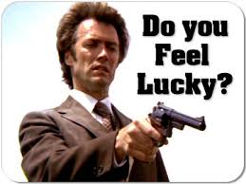
Examples of Dirty Tactics
!!!They try to intimidate you…
* If they try to control the agenda, timing, .. laugh it off with a remark such as “You’re joking” or “no way, Joe”
* If they quote their own experts’ reports at you, pass them on to your experts making no comment of your own
* If they try to bully you, use the stuck record technique.

Slide 46

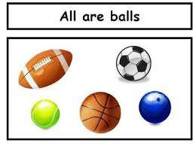
!!!They keep making generalizations…
*List specific areas for discussions
*When you here a generalization ask a question that requires a specific answer
*Break down generalizations into specific issues
*Deal with each issue in its turn

Slide 47

!!!They come with last minute demands..
*Show surprise but never show irritation or anger
*Demand extra time to think about the new issue
*Appear to treat it very seriously even if is, in fact, paltry
*Show how it will force a change in your side of the bargain
*If it really doesn’t bother you, use it as a trade for something that does

Slide 48
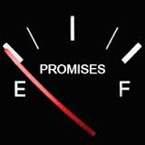
!!!They make empty promises…
*If none of the promises appear in writing, don’t believe them
*Assess whether they are important to you or not
*If they are important, make them a part of the deal
*If they are not, remind them on a regular basis

Slide 49

Summary: Competitive Strategy
“We cannot negotiate with those who say
‘what is mine is mine and what is yours is
negotiable.’ ”
John Fitzgerald Kennedy

